Slide 1
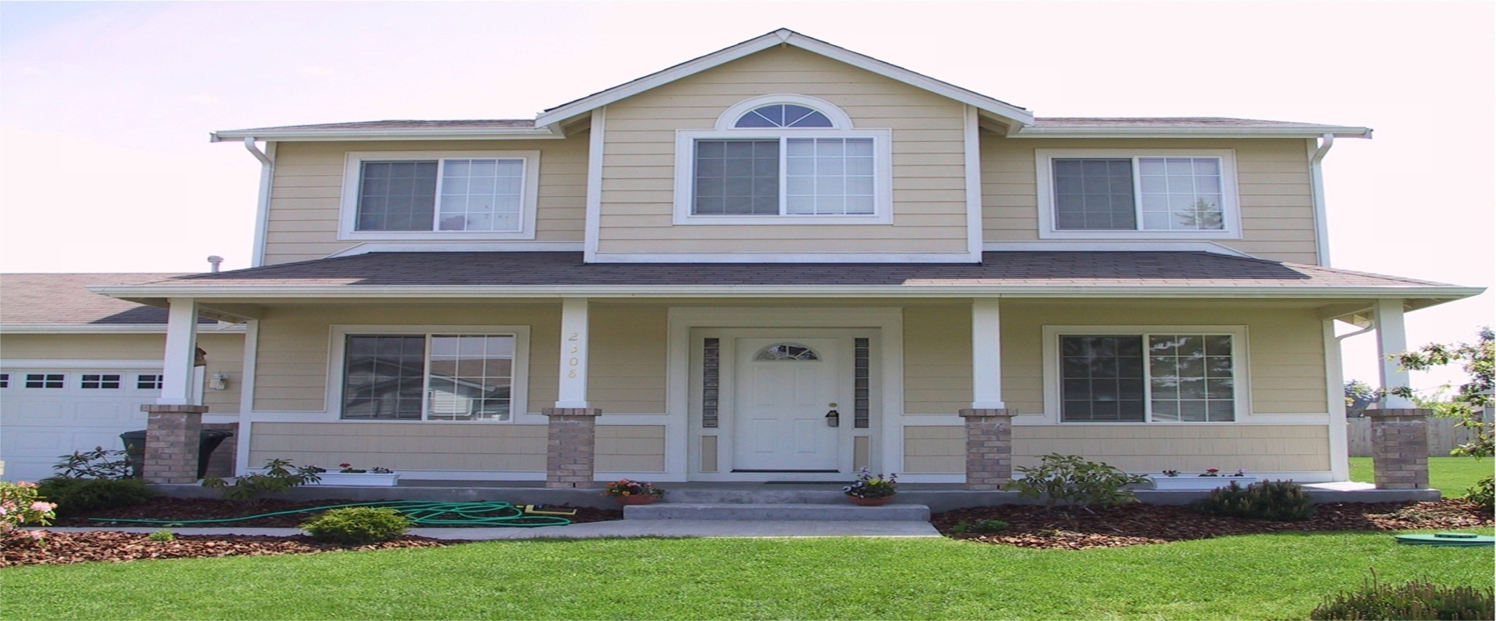
Housing – Price Prediction
BY: Arpita Rai - INT33

Slide 2
Index
1: Introduction of Housing Sector
2: Project Details.
3: Objectives.
4: Methodology.
5: Conclusion.

Slide 3
Basic HUMAN Need. Major Contributor to World Economy. Often Big Ticket Transactions. One of important decisions of Human life cycle
HOUSING SECTOR:

Slide 4
Project Introduction: Surprise Housing
1. Wants Entry in Australian Housing Market.
2. Wants to acquire properties at lower than actual value.
3. Uses Data Analytics to acquire good properties.
Dataset : Housing Sales Report of Australia.
Tool Used: Machine Learning.

Slide 5
Objective:
Predict the actual value of the prospective properties and decide whether to invest in them or not.
We also need to build model the price of houses with the available independent variables.
We need to find important features which affect the price positively or negatively.

Slide 6
Methodologies used:
Mathematical/ Analytical Modeling of the Problem
Data Sourcing and formating
Data Pre processing.
Data Input – output logic relationship.

Slide 7
Mathematical/ Analytical Modeling of the Problem
The regression models are used to examine relationships between variables.
The most traditional regression models arr:
Linear regression
Decision tree regression,
Random forest regression
Gradient boosting regression
KNN-Neighbors.

Slide 8
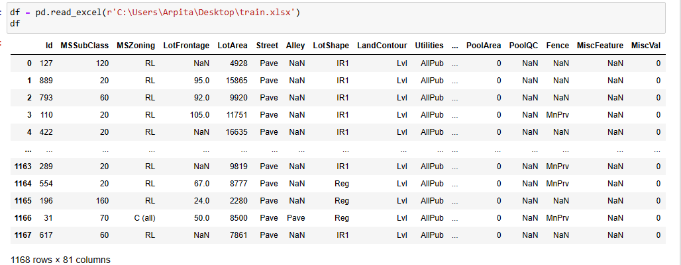
Data Sourcing and formating
The dataset is given by a US-based housing company named Surprise Housing . The company uses data analytics to purchase houses at a price below their actual values and flip them at a higher price. For the same purpose, the company has collected a data set from the sale of houses in Australia.

Slide 9
Data Pre processing.
Importing libraries
Importing data
Checking Total Numbers of Rows and Column
Checking All Column Name
Checking Data Type of All Data
Checking for Null Values
Information about Data
Checking total number of unique value
Checking all value of each columns
Handling Null Values by filling with mean and mode

Slide 10
Data Inputs- Logic- Output Relationships
Checking for Correlation
Plotting Correlation on heatmap
Checking for Outliers
Removing Outliers
Scaling and splitting data
Concatenating both train and test data.

Slide 11
Conclusion:
1. We compared the predicted and actual price the house
2: Gradient Boosting Regressor was the best suited model
3: It gave accuracy of 87.5
4: The target column is not having a negative correlation with any of the
existing feature and it has a positive relation with OverallQual.
5: We removed Outliers by using ZSCORE method.
6: If the house is built 140 years ago then its price is less and between
zero to twenty years the price is high
7: The newer house(which are built or renovated 10-20 year ago)are
having highest sales price.
8: There is a huge difference between 75th percentile and the maximum
value in the features like MSSubClass,LotFrontage,LotArea etc.
9: Mean is greater than median in features like MSSubClass,
MasVnrArea,BsmtFinSF1,BsmtFinSF2.

Slide 12
Thank YOU

